Slide 1
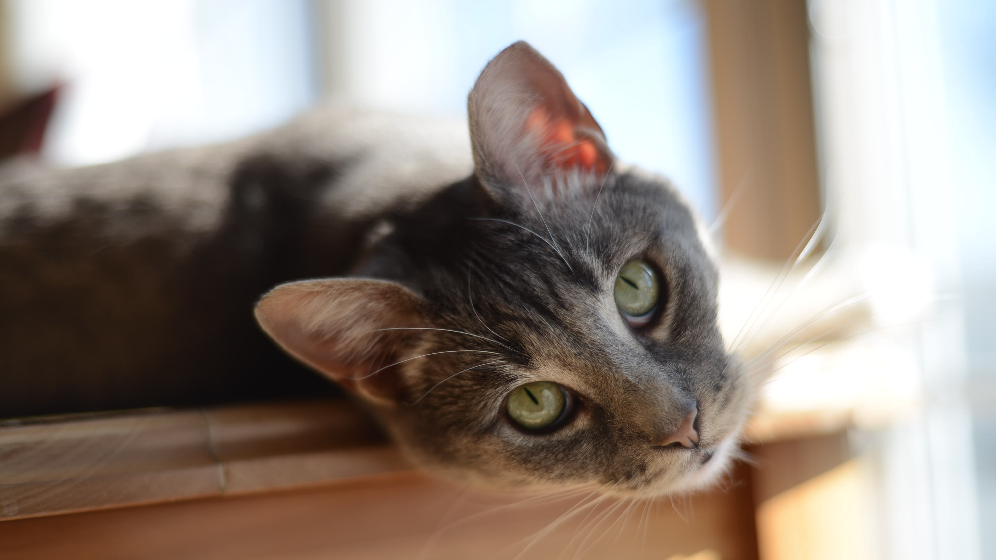
Kat’s Photography Portfolio 2021
By Kat Procacci

Slide 2
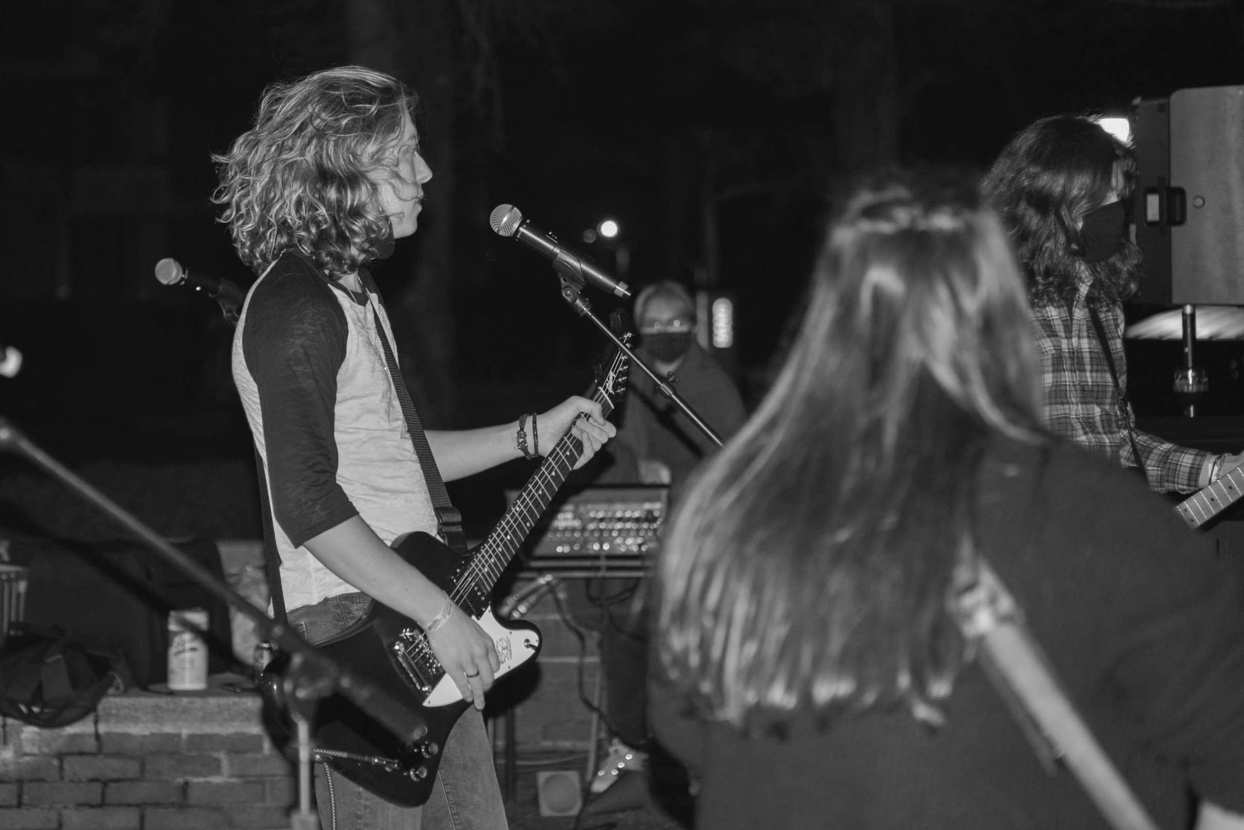
A guitar player strums along with the rest of his bandmates. The band performed at Hand’s Got Talent, an event that took place during the Stony Brook Staycation.

Slide 3
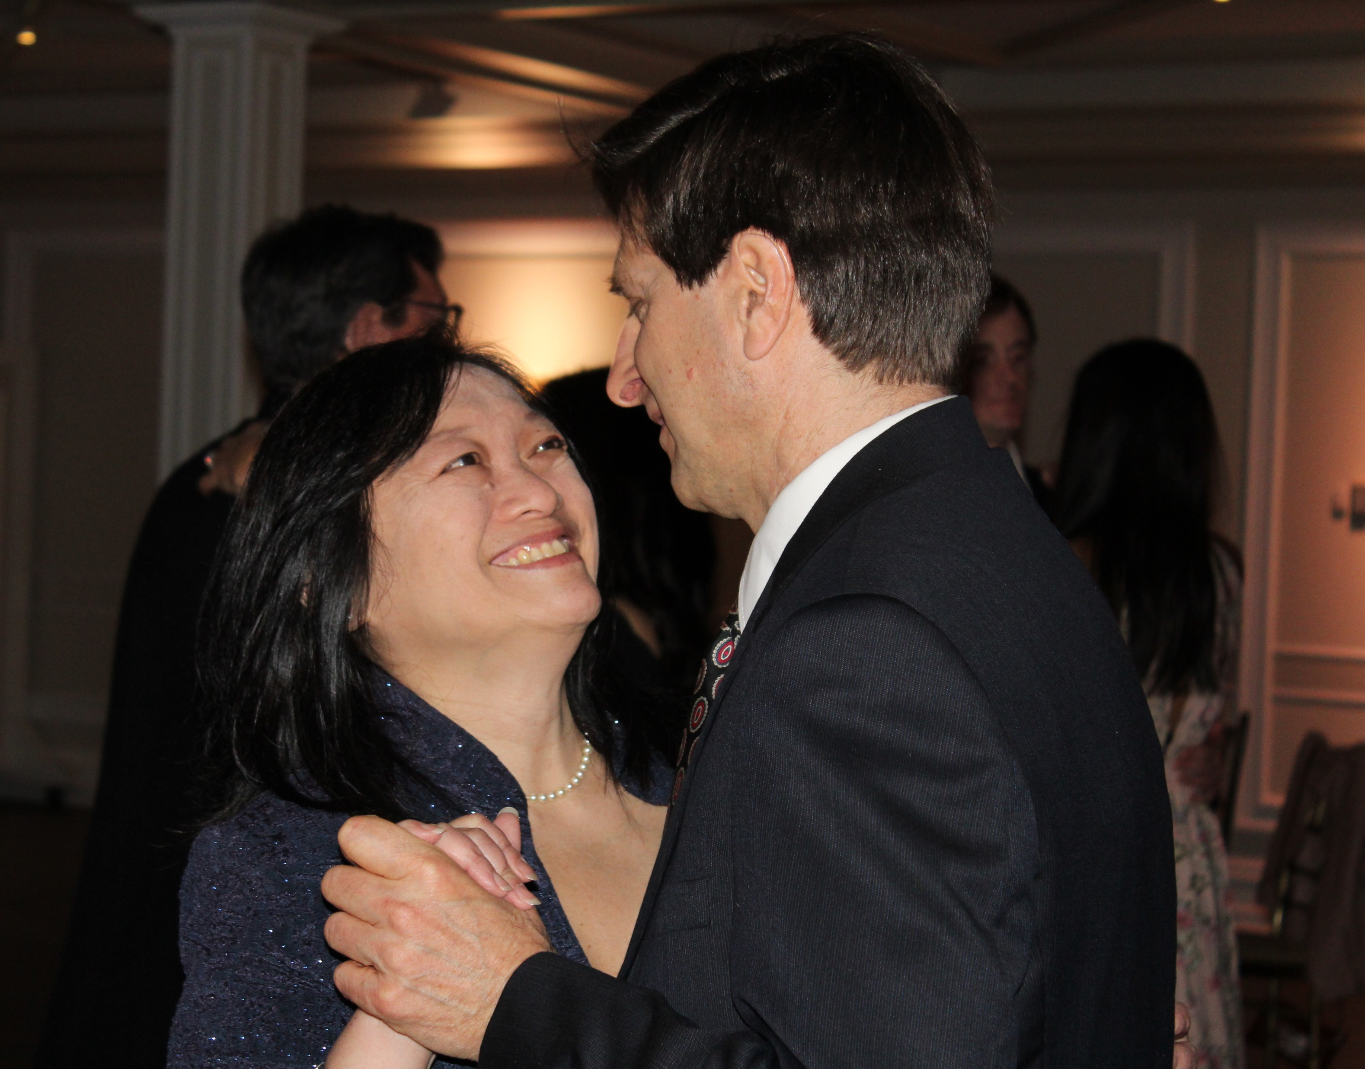
Lily and Felix Procacci dance at their niece, Lauren’s, wedding. In August, they will be married for 22 years.

Slide 4
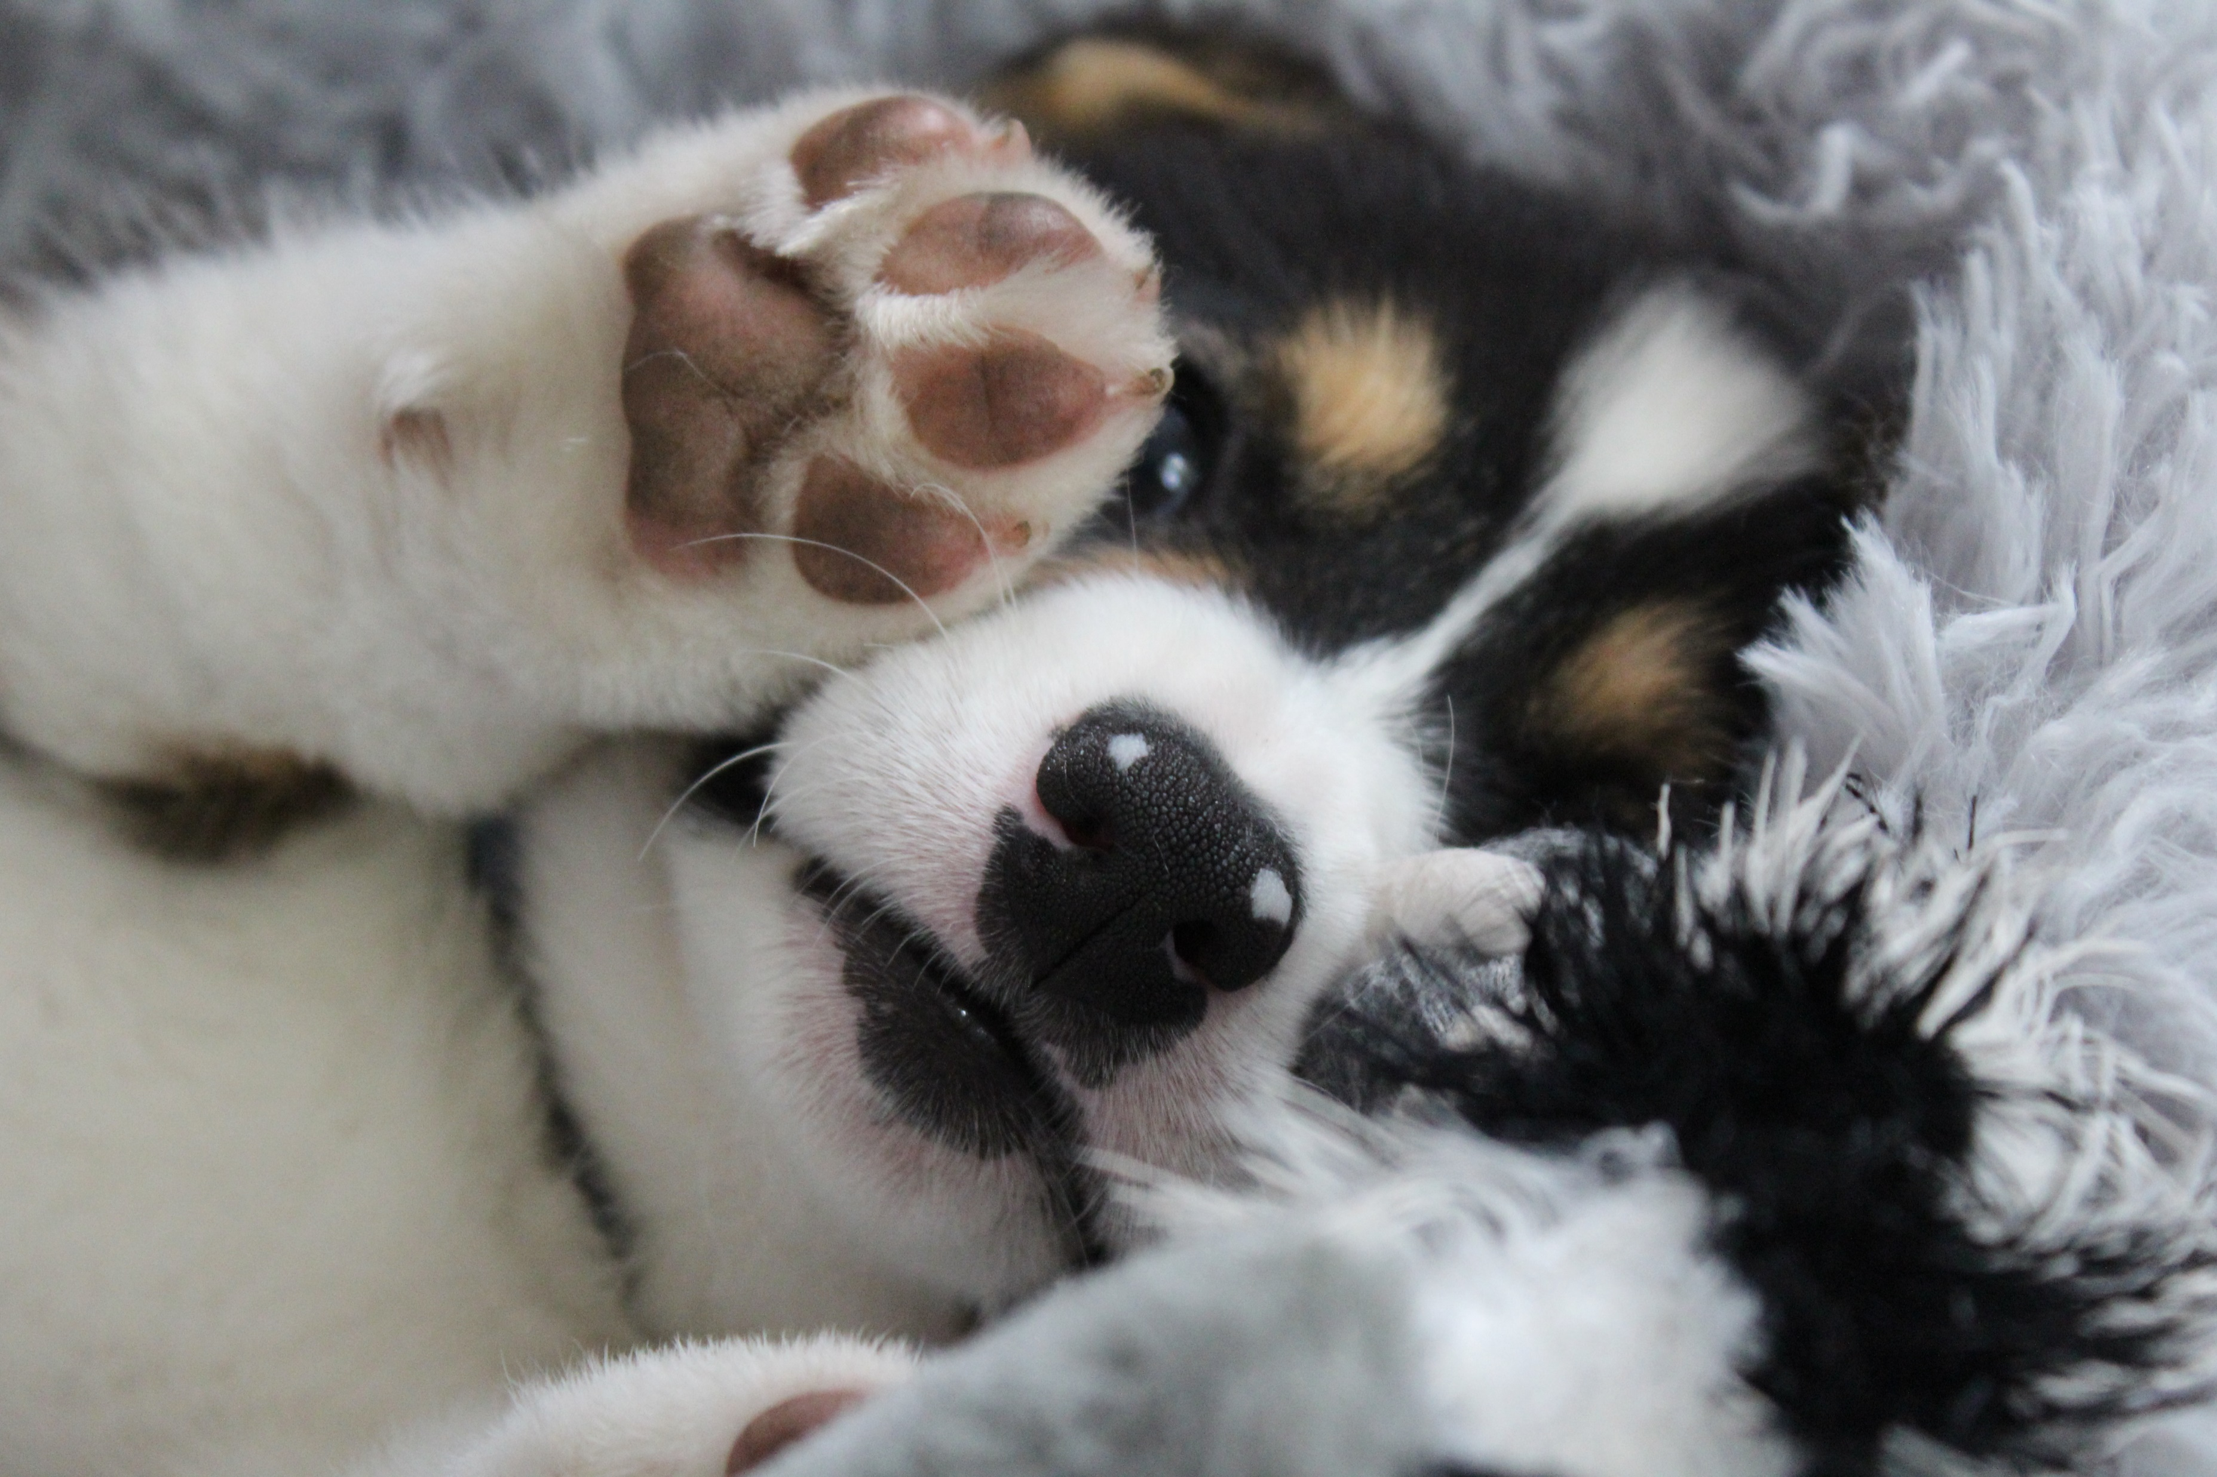
Cody the corgi plays with his skunk-shaped toy. Cody was adopted by Marissa Lidner and has been with her for two weeks.

Slide 5
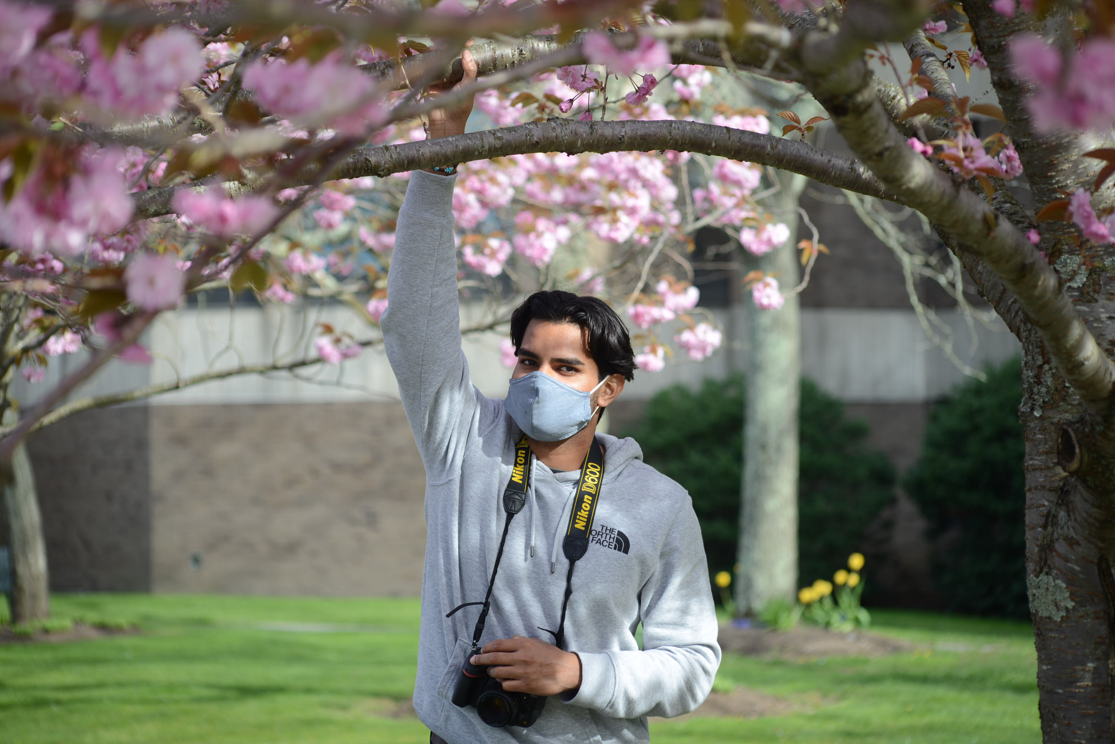
Elisha Asif

Slide 6
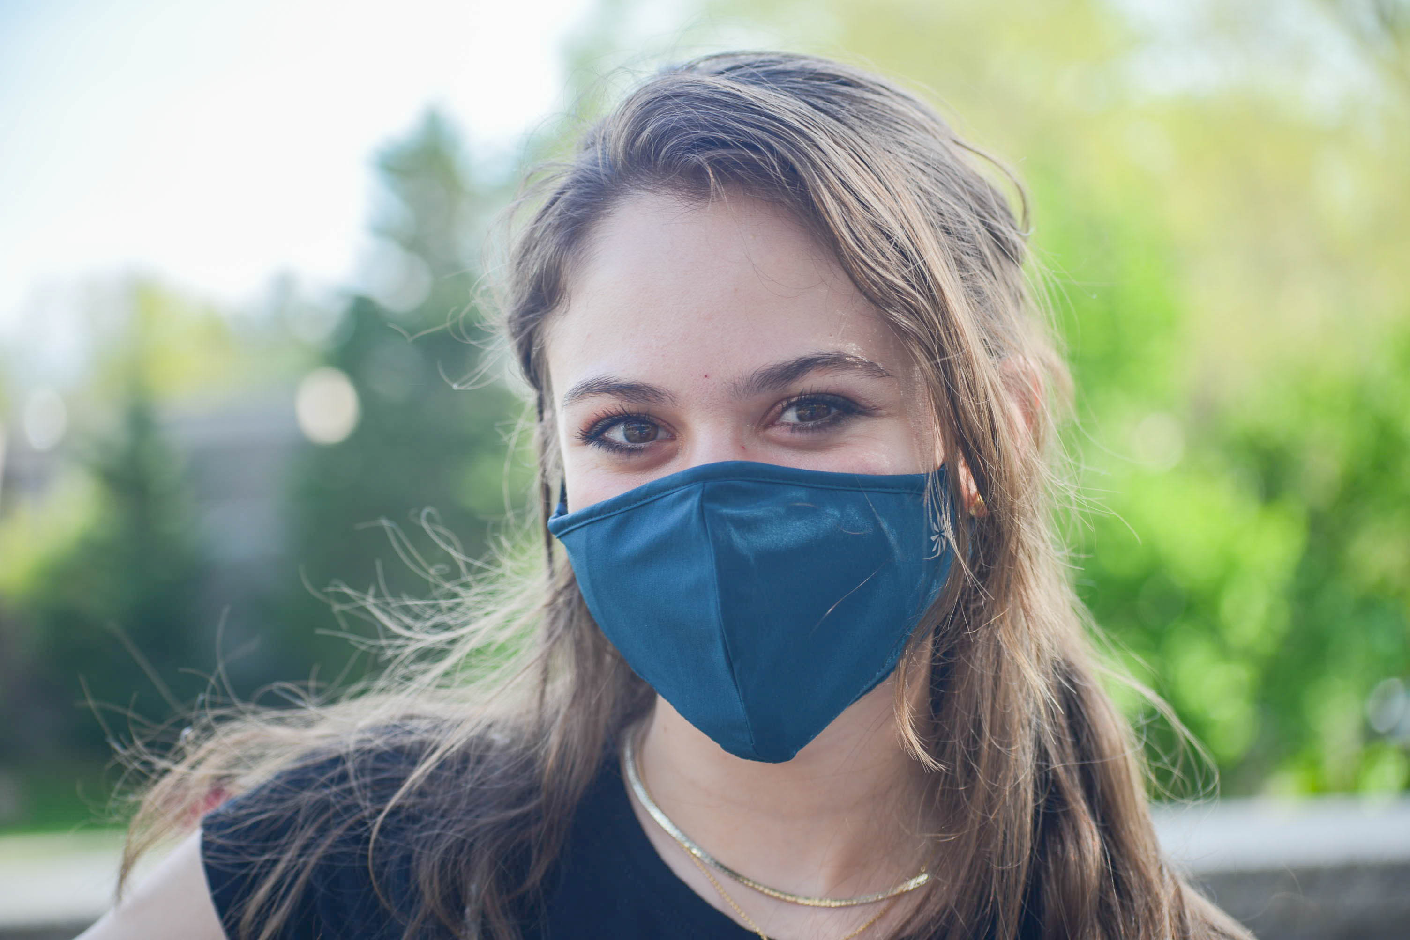
Zornista (Zoey) Peeva

Slide 7
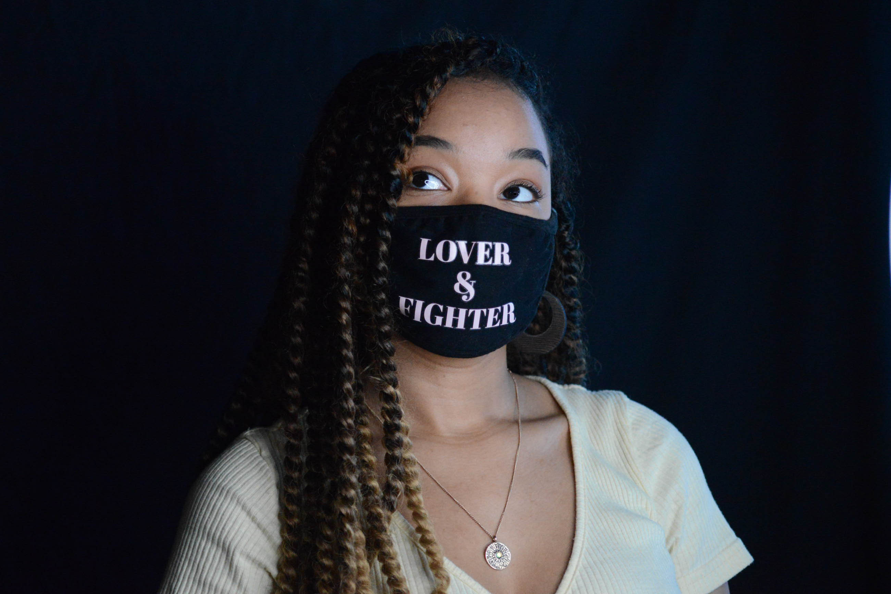
Katelyn Heredia

Slide 8
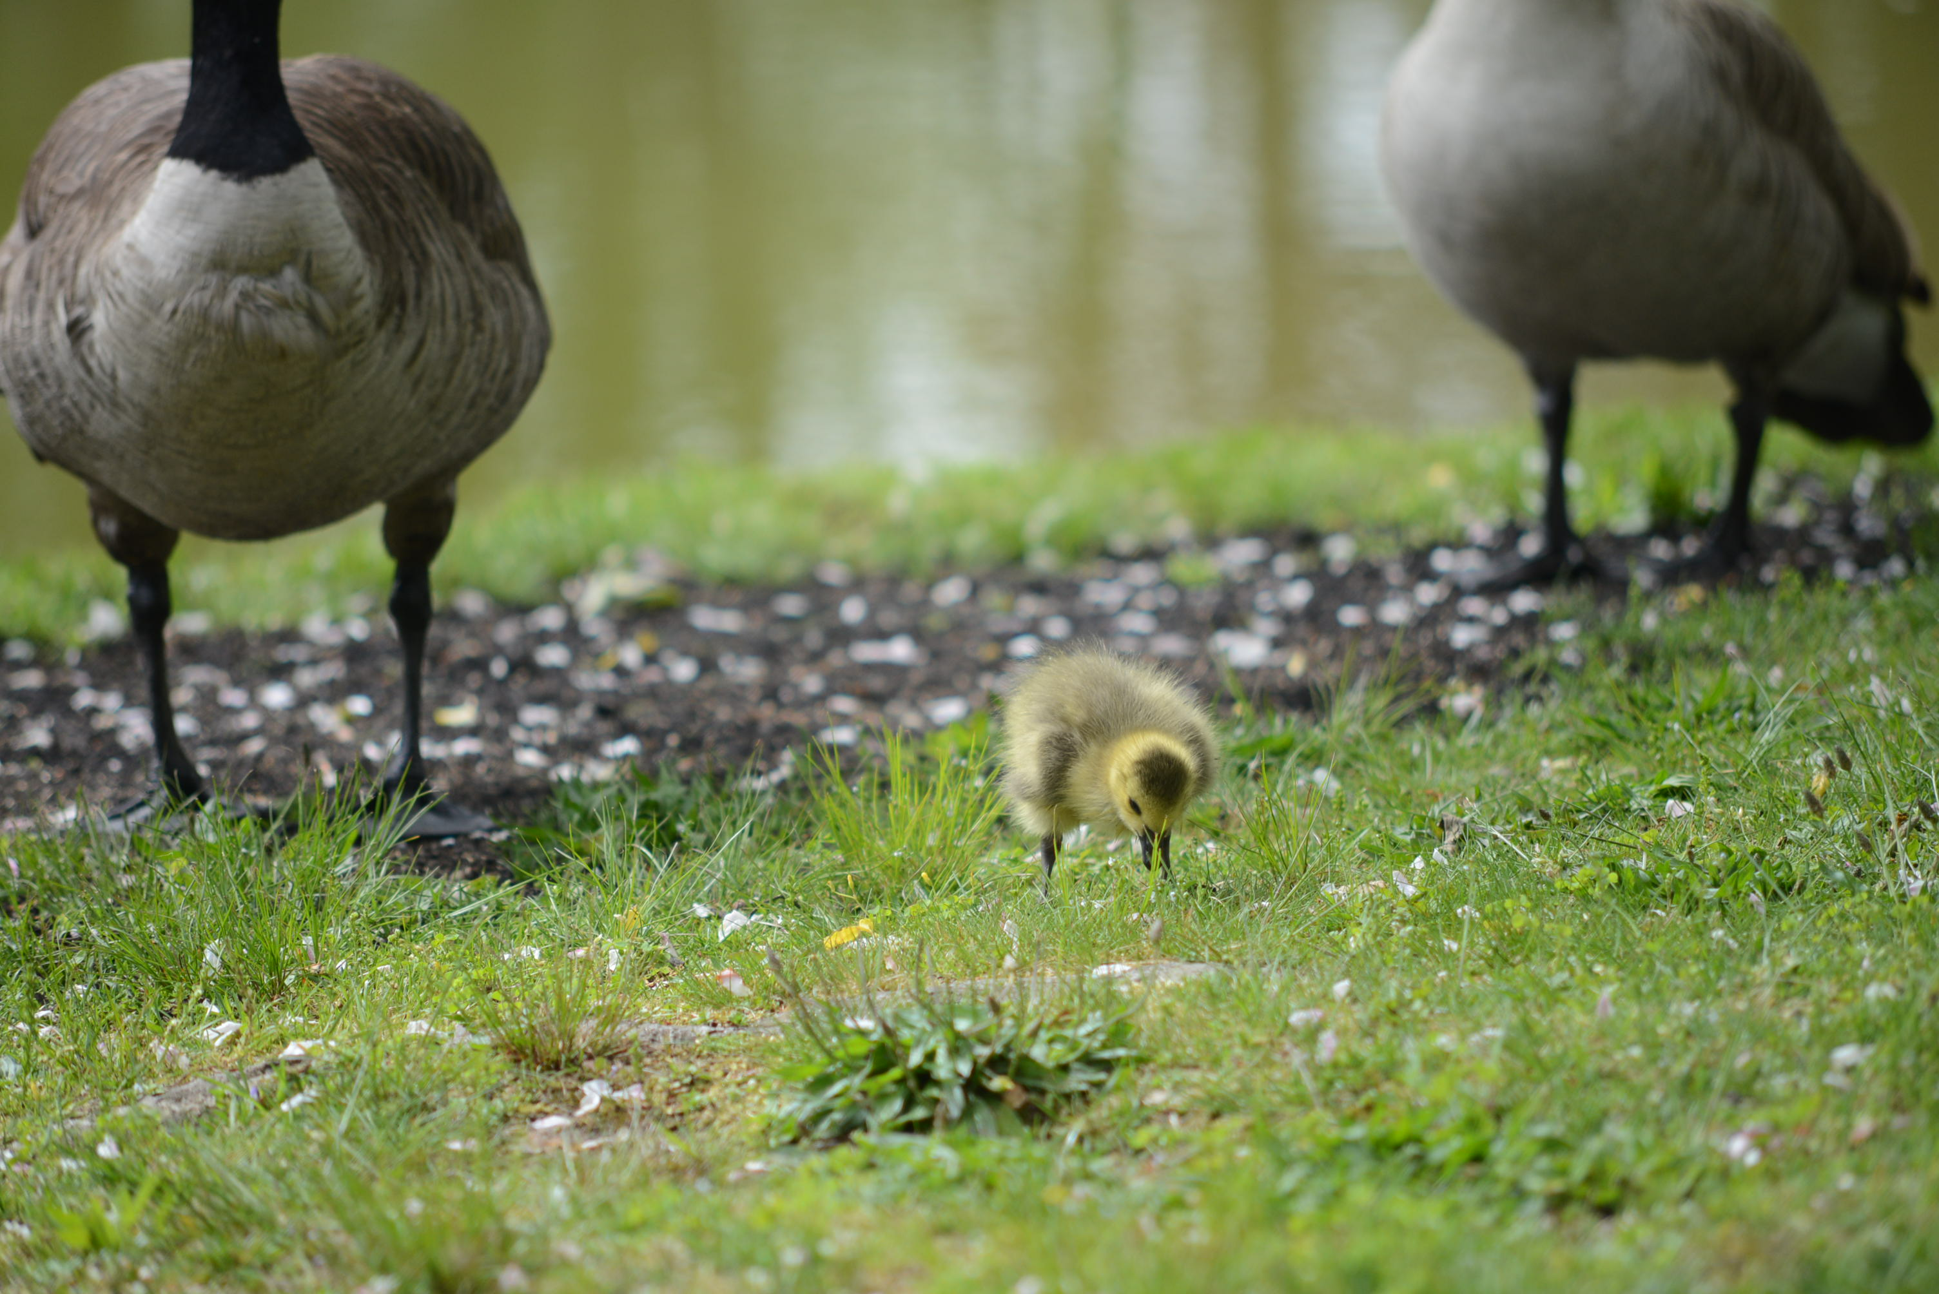
A baby gosling pecks at the grass along Roth Pond as the parents stand guard behind them.

Slide 9
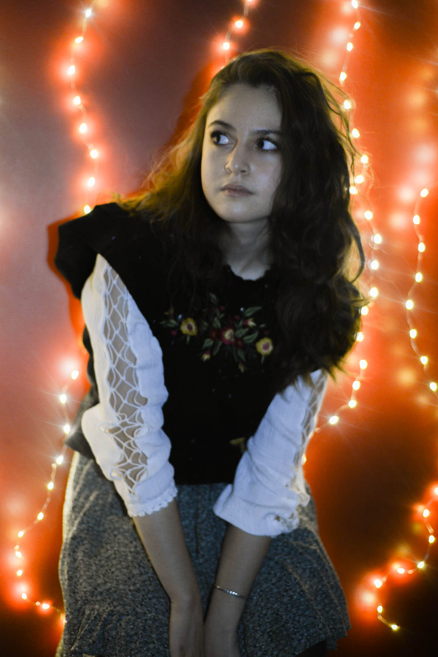
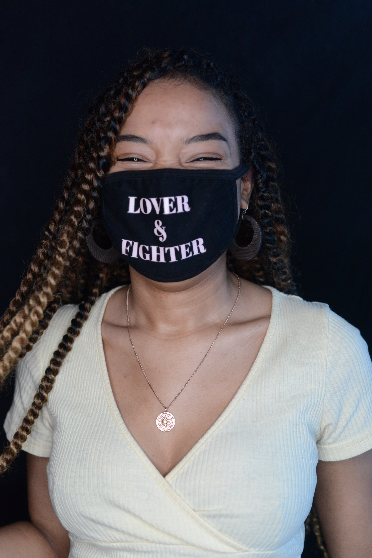
Zornista (Zoey) Peeva
Katelyn Heredia

Slide 10
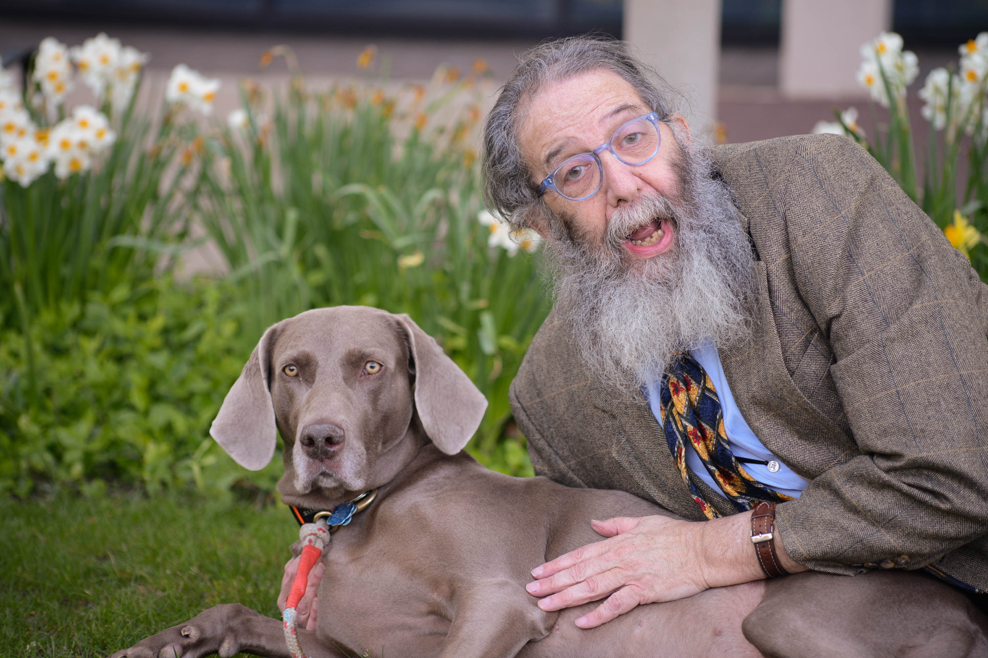
Professor Jonathon Sanders poses with his dog, Kodak, as he explains how to practice ‘Bokha’ to his Photojournalism class. Professor Sanders regularly brings Kodak to class as his assistant and as the class model.

Slide 11
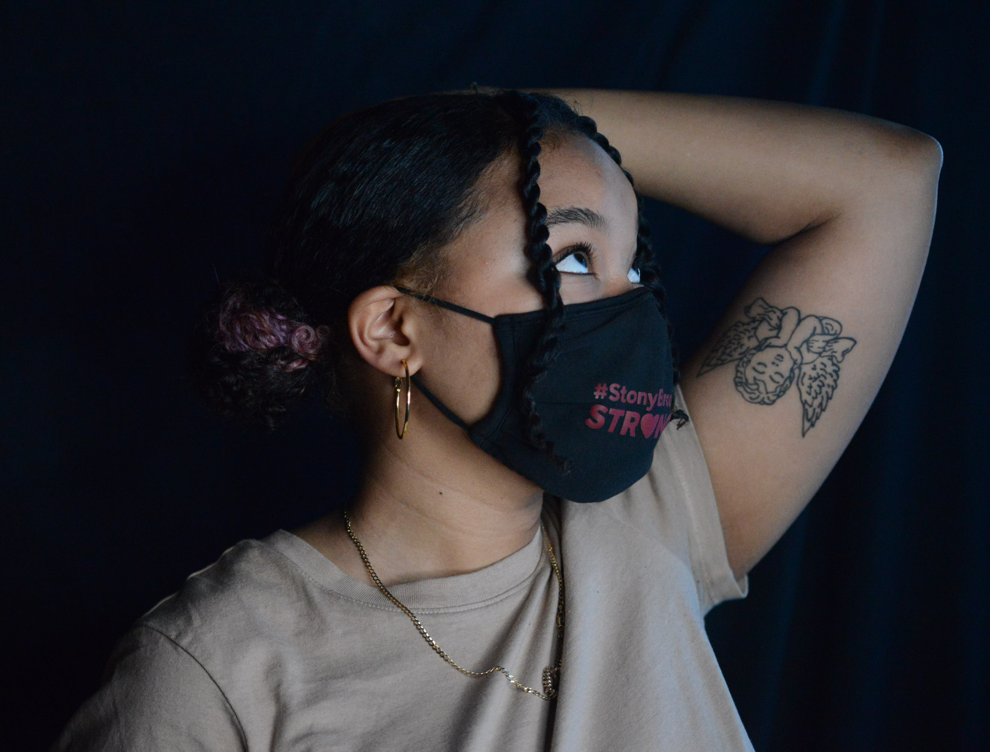
Katherine Heredia

Slide 12
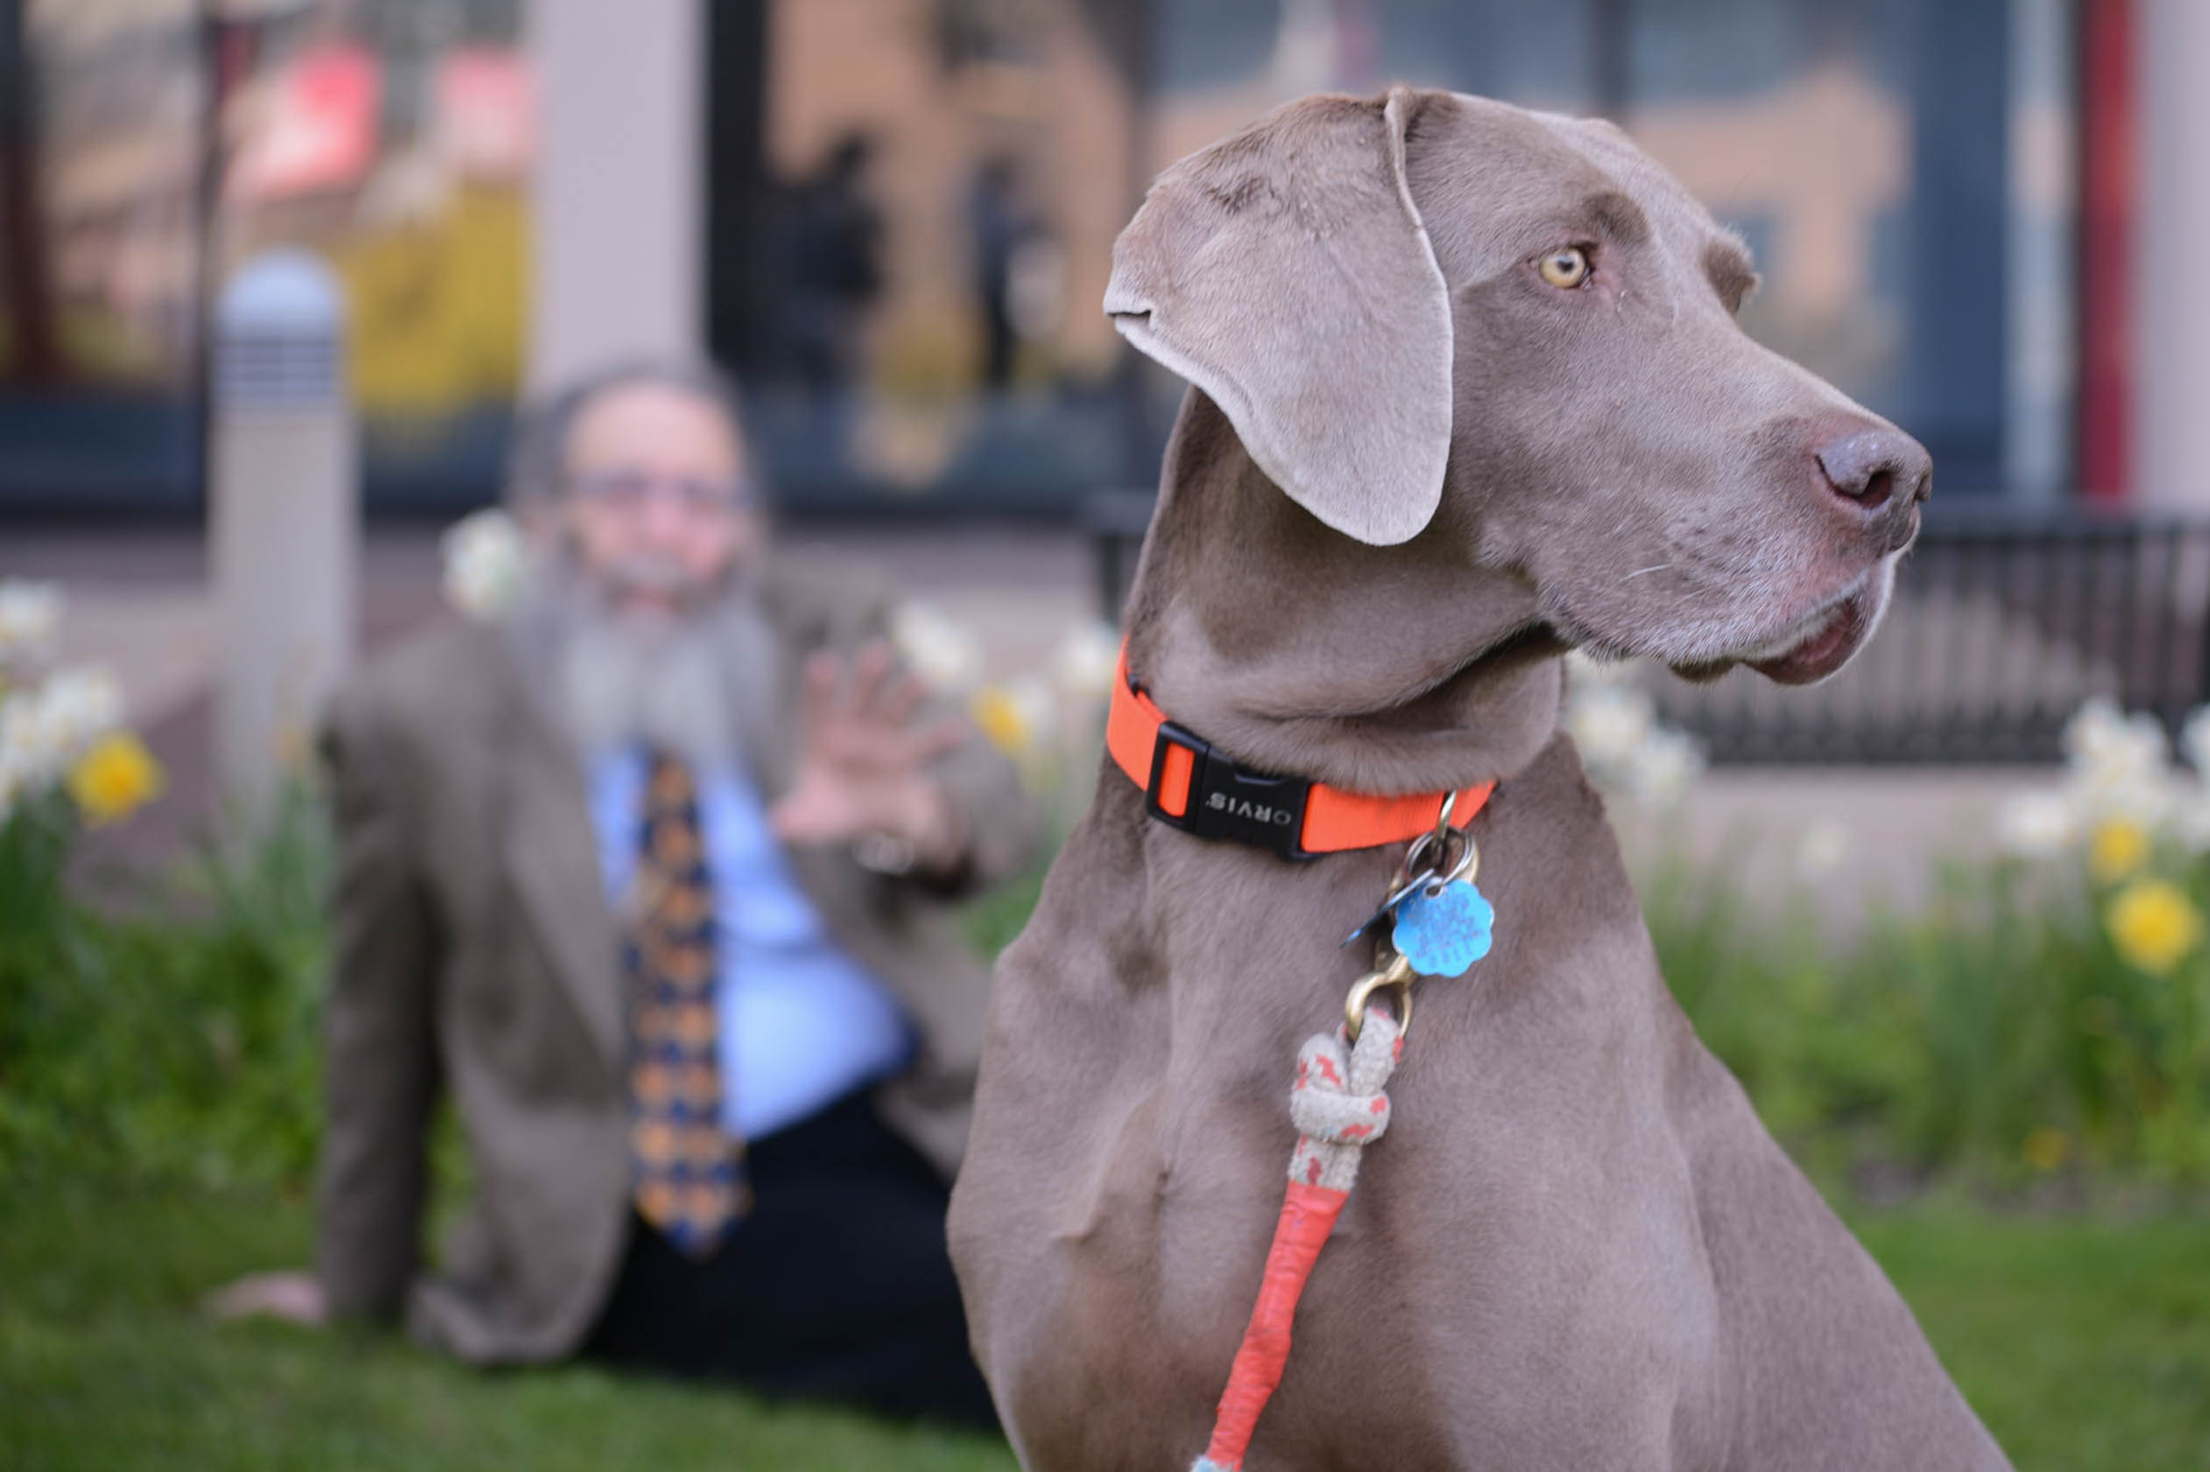
Kodak, Professor Sanders’s dog, poses for the camera as Professor Sanders teaches Bokeh. Bokeh is the quality of blur in out-of-focus parts of a photograph.

Slide 13
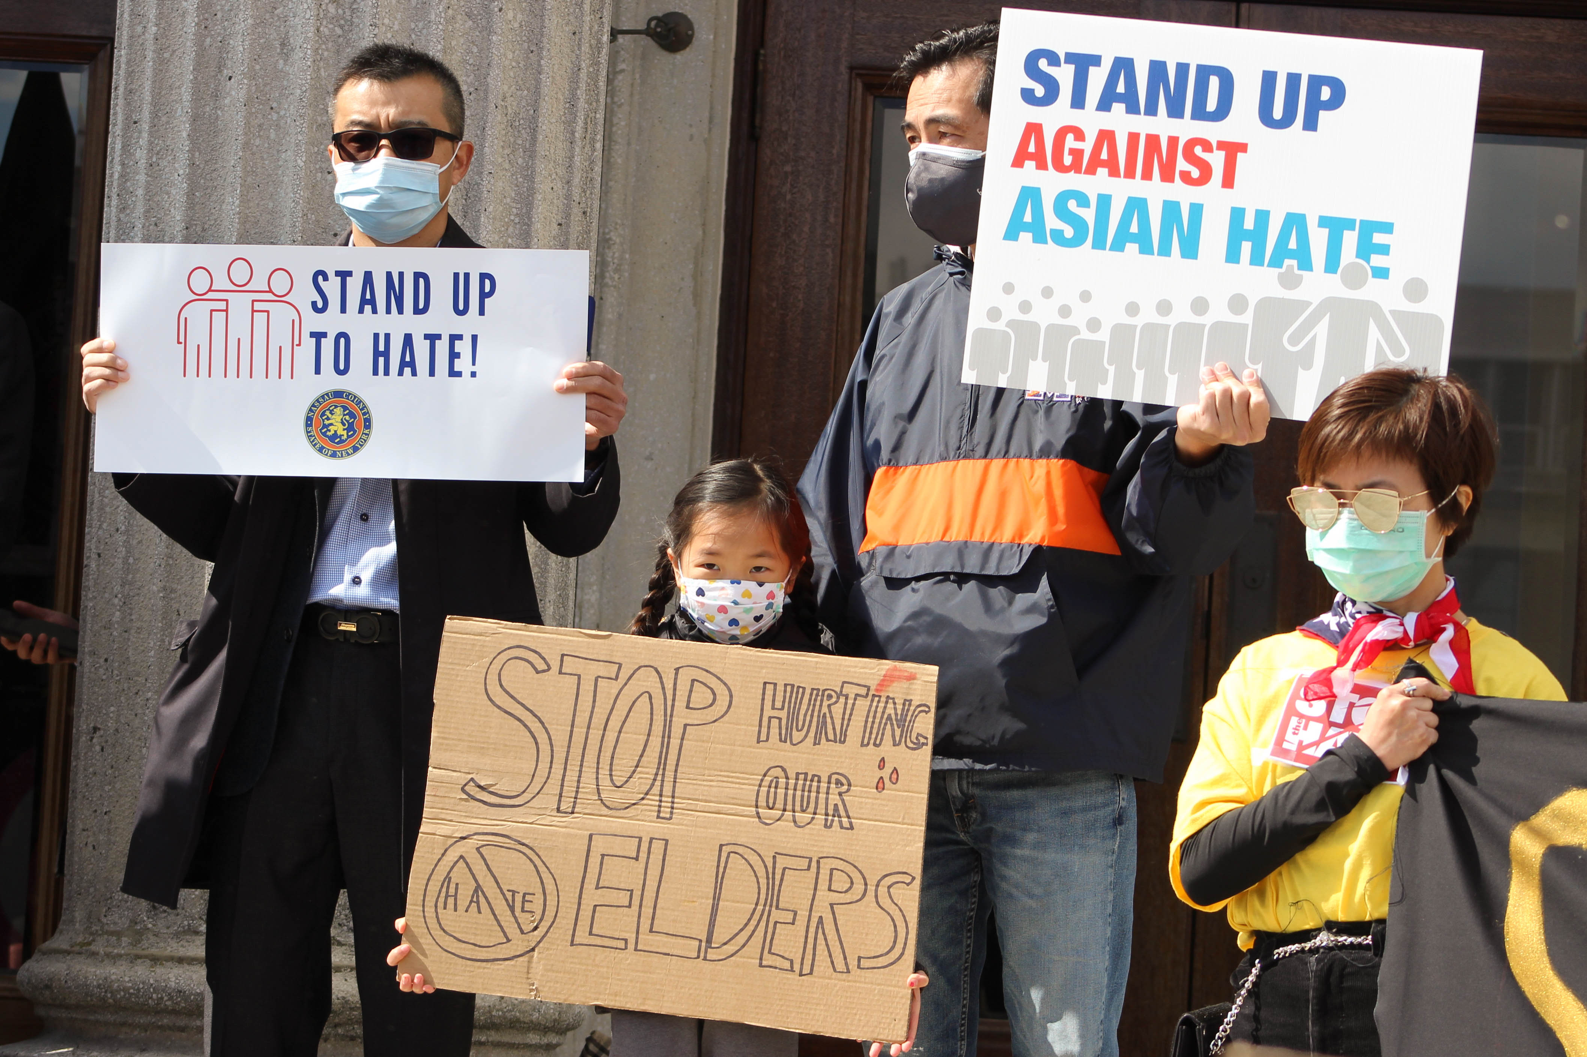
A little girl holds up a poster that reads “Stop Hurting Our Elders” at a Stop Hate Rally. The Rally was in response to the increase of violence against Asian people since the start of the COVID-19 Pandemic.

